Slide 2
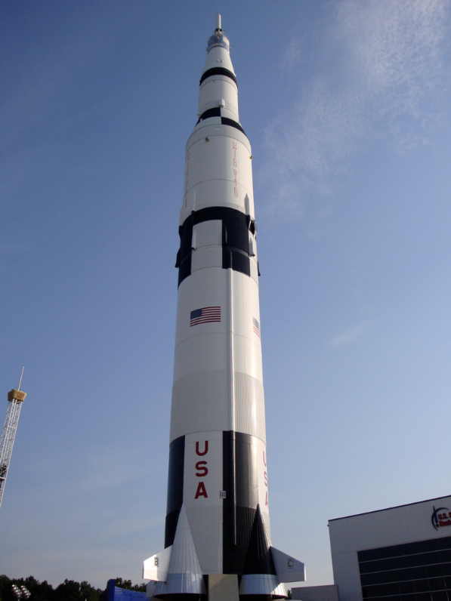
On the morning of July 16th 1969, the United States of America got ready to launch its Saturn V rocket from launch pad 39A at Cape Kennedy, Florida, USA.
Photo courtesy of kelliwhitman (@flickr.com) - granted under creative commons licence - attribution

Slide 3
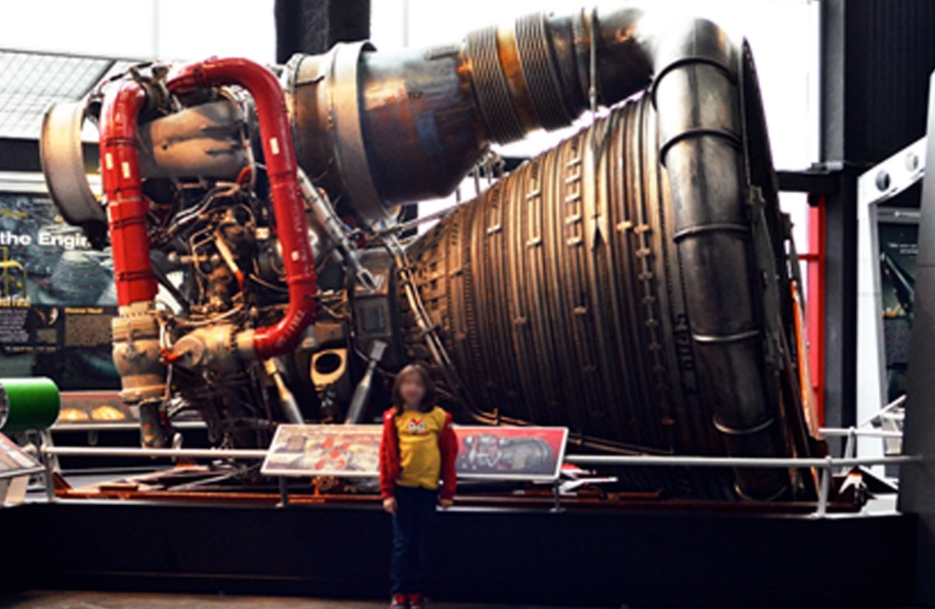
Saturn 5 was the largest rocket ever built. It was 111 metres high, that’s taller than the Statue of Liberty and taller than many tower blocks. It weighed 2.9 million kilograms (2 900 000 kg) when it was full of fuel.
Saturn V had 5 gigantic F1 engines to launch it into space.
Even more engines were used later on in its journey.
Here is just one of the five F1 engines. They really were massive!
Photo courtesy of kelliwhitman (@flickr.com) - granted under creative commons licence - attribution

Slide 4
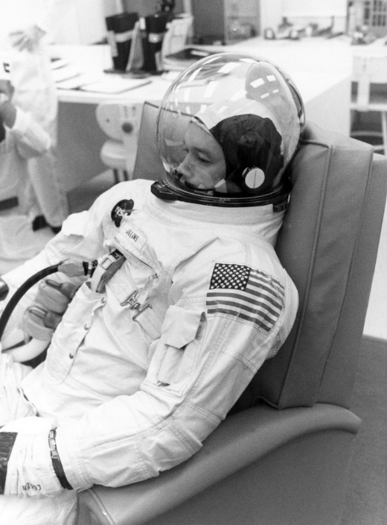
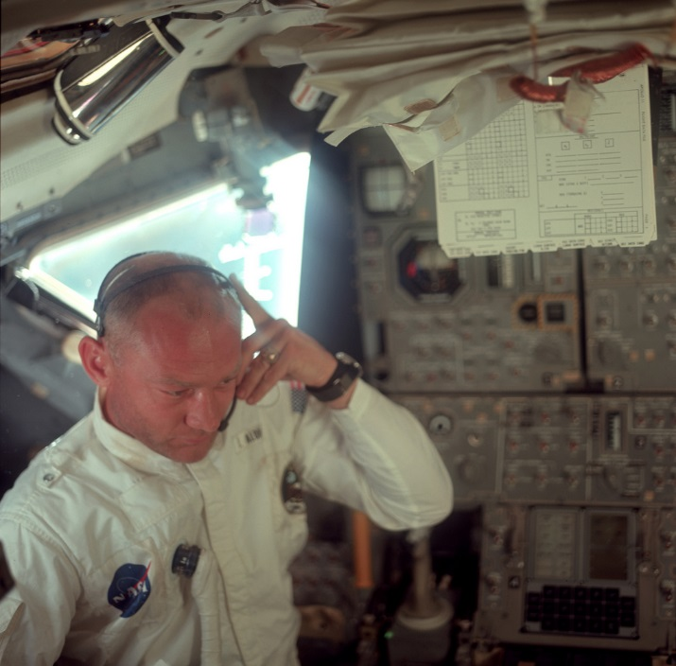
Three astronauts were on board Saturn V: Neil Armstrong, Michael Collins and Edwin “Buzz” Aldrin. The astronauts had to go through lots of training to move around in their bulky spacesuits, and test all the spacecraft’s equipment.
Astronaut Michael Collins during
a practice for the Apollo 11 mission.
Astronaut Buzz Aldrin inspecting
the Saturn V rocket.
Photo courtesy of NASA (@flickr.com) - granted under creative commons licence - attribution

Slide 5
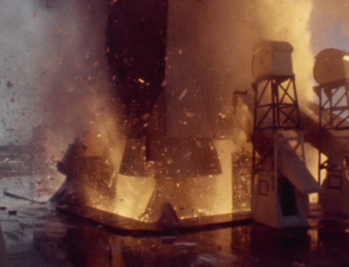
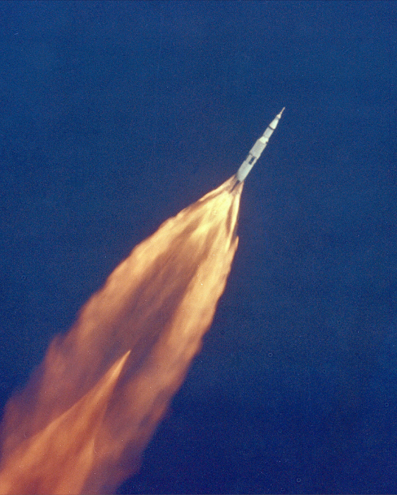
On launch day, Collins, Armstrong and Aldrin sat at the very top of Saturn V in the command module. At 9:32am Saturn V’s engines fired and the rocket launched off from its tower. Twelve minutes later, the astronauts were orbiting Earth.
The moment when Saturn V’s F1 engines fired,
launching it from its tower.
The Saturn V rocket blasts
into space.
Photo courtesy of NASA (@flickr.com) - granted under creative commons licence - attribution

Slide 6
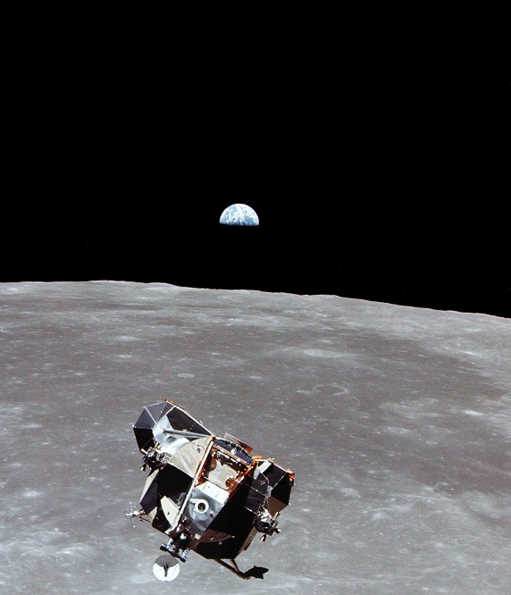
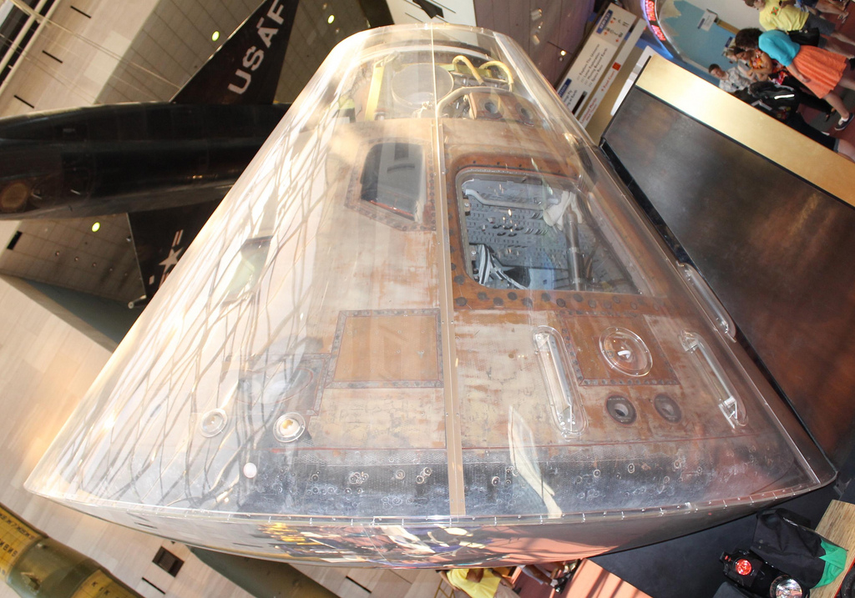
The Apollo 11 crew took 4 days to reach the Moon.
Once they were orbiting the Moon, Armstrong and Aldrin climbed into the
Eagle Lunar Module and landed on the Moon.
Collins stayed in the Columbia Command Module.
The Eagle Lunar Module which carried Armstrong and Aldrin down to the land on the Moon.
The Columbia Command Module at the National Air and Space Museum in the USA.
Photo courtesy of NASA and Charles Atkeison µg (@flickr.com) - granted under creative commons licence - attribution

Slide 7
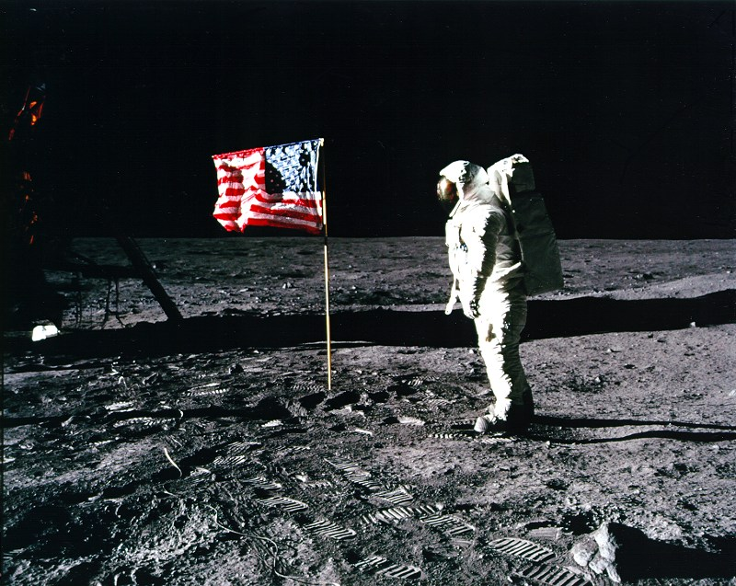
On July 20, 1969, Neil Armstrong became the first human to step on the moon. He and Aldrin walked around for three hours. They did experiments. They picked up bits of moon dirt and rocks. They put a U.S. flag on the moon. They also left a sign on the moon.
Armstrong and Aldrin placed an American flag on the surface of the Moon.
Photo courtesy of Purpleslog (@flickr.com) - granted under creative commons licence - attribution

Slide 8
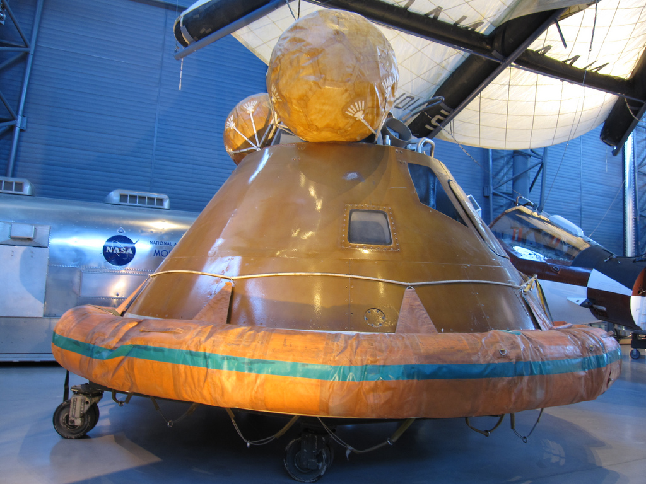
After 22 hours on the Moon, Armstrong and Aldrin returned to the command module using Eagle. The Apollo 11 crew returned to Earth and landed in the Pacific Ocean on 24th July. The module had a special heat shield which stopped it from burning up as it travelled through the Earth’s atmosphere.
The Columbia Command Module has a custom made flotation collar to help it float when it landed in the Pacific Ocean.
Photo courtesy of Bernt Rostad (@flickr.com) - granted under creative commons licence - attribution

Slide 9
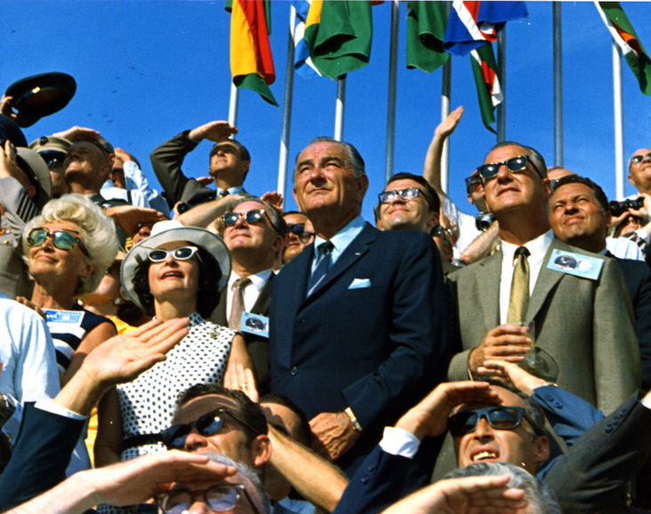
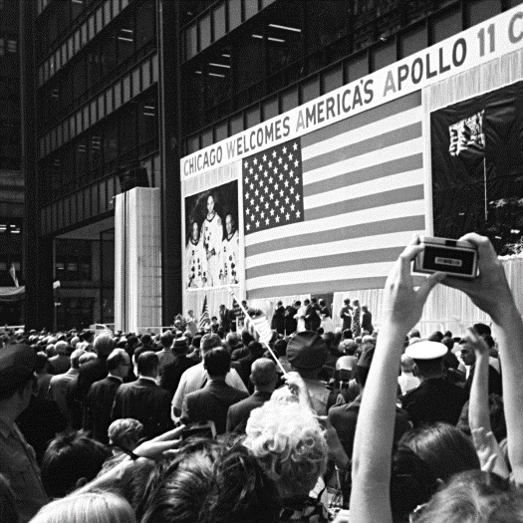
The Apollo 11 Moon landing was the most watched event in the history of television, nearly 600 million people watched. Across the USA people held Moon parties, recorded their thoughts in letters and took family photos. Nobody was going to forget the day that man first walked on the Moon.
Photo courtesy of NASA and Osbornb (@flickr.com) - granted under creative commons licence - attribution

